Slide 1
Concurrency Control

Slide 2
Concurrency Control
Concurrency control mechanism is responsible for maintaining the database consistency in case of concurrent execution.
Following are the most common concurrency control protocols:
Lock based protocol
Graph Based protocol
Time stamp based protocol
Validation based protocol

Slide 3
Lock-Based Protocols
Inconsistency occurs when two transactions attempt to modify the same data item at the same time.
A general solution to this problem is that, if one transaction is accessing a data item then, no other transaction should be allowed to modify that data item.
Locks are used to implement this general solution.
Lock- is a variable associated with each data item that describes the status of the item with respect to possible operations that can be applied to it.

Slide 4
Locks
There are two types of locks:
Binary locks
Shared/Exclusive locks
A binary lock can have two states-locked and unlocked.
The function lock(X) tells that whether data item X is locked or not at a given time.
If lock(X)=1 then, X is locked and if lock(X)=0 then, X is not locked.
A transaction can request and release a lock on data item X by using following two instructions:
Lock_item(X)
unlock_item(X)

Slide 5
Locks
Main drawback of binary lock is that at a given point of time, at most one transaction can hold a lock on data item X. But, in database system it should be allowed that multiple transactions may access a data item only for reading.
To overcome this problem, we use shared/exclusive lock.

Slide 6
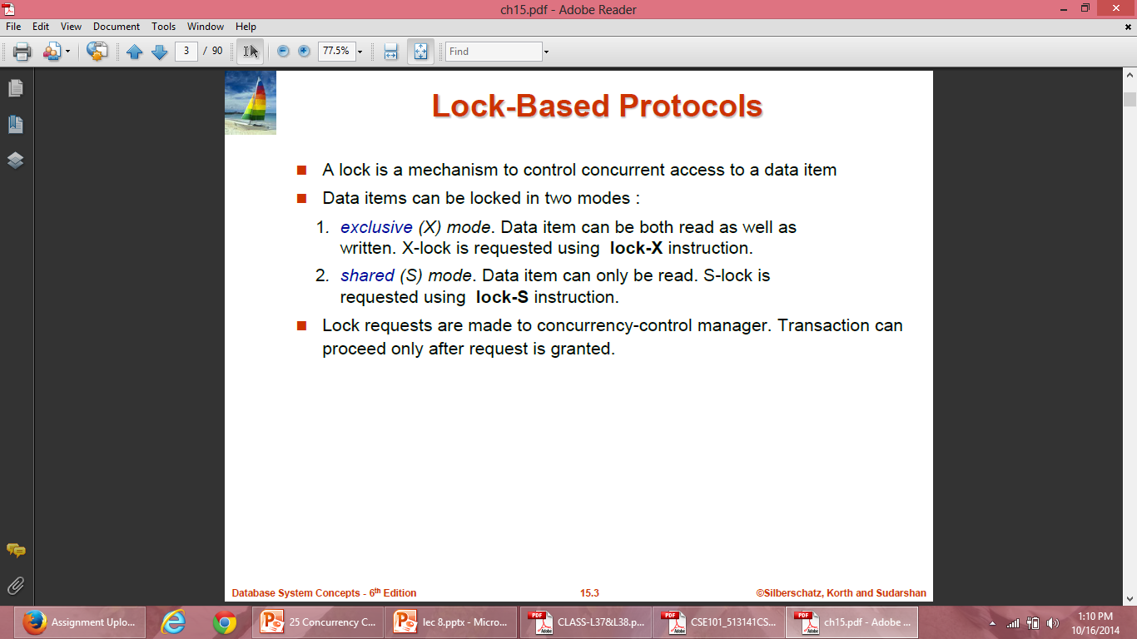
Locks

Slide 7
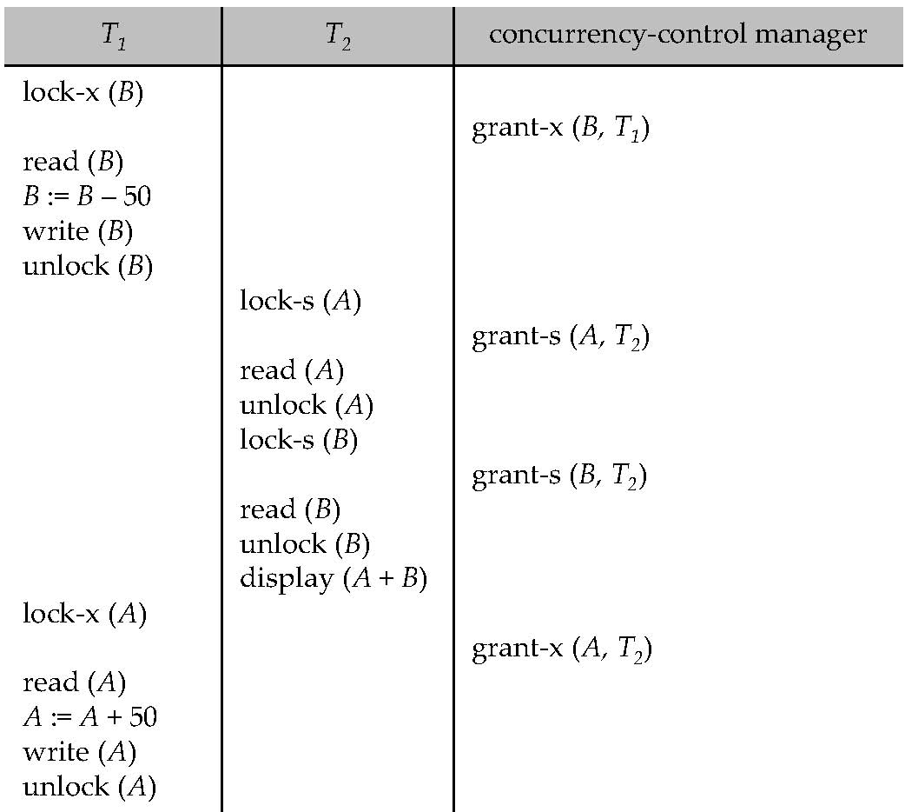
Locks

Slide 8
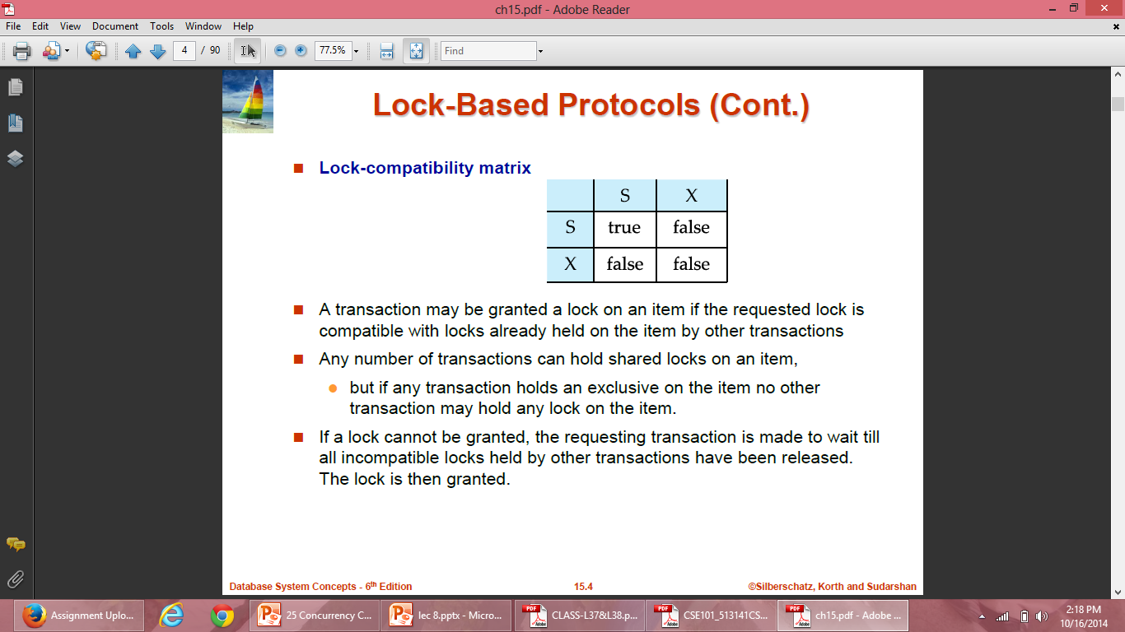
Compatibility Function
Compatibility function can be defined as:
Let M and N be two lock modes. Now suppose that a transaction Ti requests a lock of mode M on data item A on which transaction Tj currently holds a lock of mode N. If transaction Ti can be granted a lock on A immediately inspite of presence of lock of mode N, then mode M is said to be compatible with mode N.

Slide 9
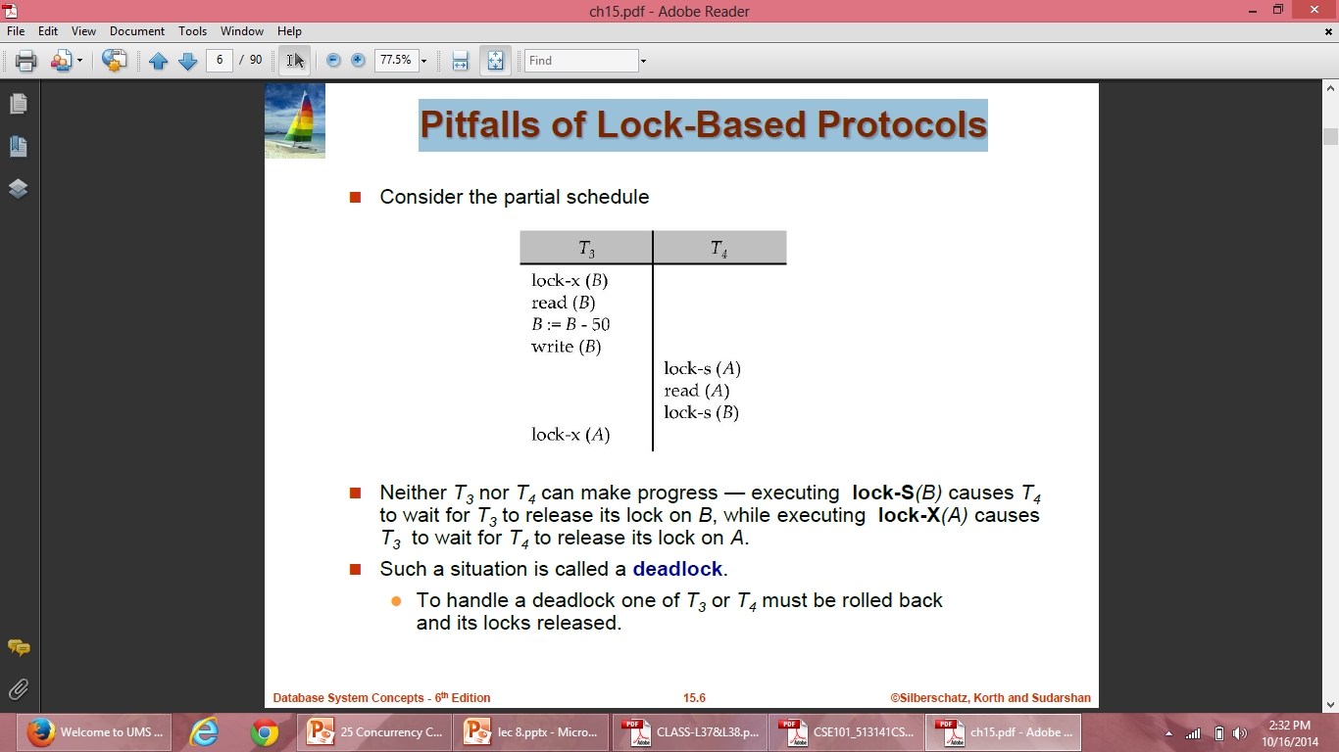
Pitfalls of Lock-Based Protocols
Notes:
We have arrived a state where neither of the transactions can ever proceed with normal execution. This situation is called deadlock

Slide 10
Pitfalls of Lock-Based Protocols
Starvation is the situation when a transaction has to wait for a indefinite period of time to acquire a lock.
Starvation is also possible if concurrency control manager is badly designed. For example: A transaction may be waiting for an X-lock on an item, while a sequence of other transactions request and are granted an S-lock on the same item.
The same transaction is repeatedly rolled back due to deadlocks.
Concurrency control manager can be designed to prevent starvation.

Slide 11
Starvation- Example
Starvation can be best explained with the help of an example –
Suppose there are 3 transactions namely T1, T2, and T3 in a database that are trying to acquire a lock on data item ‘ I ‘ .
Now, suppose the scheduler grants the lock to T1(may be due to some priority), and the other two transactions are waiting for the lock.
As soon as the execution of T1 is over, another transaction T4 also come over and request lock on data item I.
Now, this time the scheduler grants lock to T4, and T2, T3 has to wait again .
In this way if new transactions keep on requesting the lock, T2 and T3 may have to wait for an indefinite period of time, that leads to Starvation.

Slide 12
Lock-Based Protocols
A locking protocol is a set of rules followed by all transactions while requesting and releasing locks. Locking protocols restrict the set of possible schedules.
Two types of lock based protocol is:
Two-phase locking protocol
Protocol which is not two phase:
Graph based protocol

Slide 13
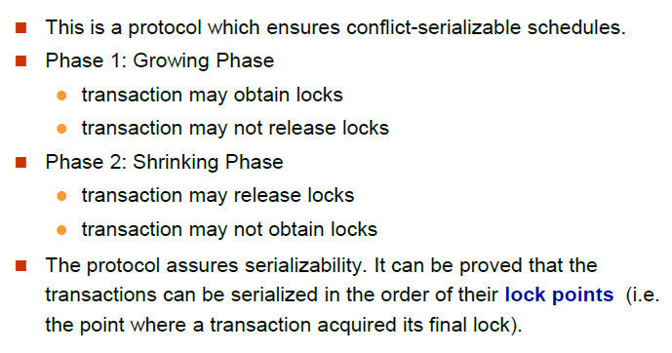
The Two-Phase Locking Protocol

Slide 14
The Two-Phase Locking Protocol
Cascading rollback may occur in Two phase locking so in order to avoid it three variations on two phase locking is used:
Strict two-phase locking : Here a transaction must hold all its exclusive locks till it commits/aborts.
Rigorous two-phase locking : is even stricter: here all locks are held till commit/abort. In this protocol transactions can be serialized in the order in which they commit.
Two phase locking with Lock Conversion: This protocol adds the ability of lock conversion to the basic two phase locking. i.e we can convert a shared lock to an exclusive lock and vice versa. The Upgrade(A) instruction is used to convert a shared lock to an exclusive lock. The Downgrade(A) instruction is used to convert an exclusive lock shared lock.

Slide 15
Graph Based Protocol
Graph-based protocols are an alternative to two-phase locking
This protocol requires prior knowledge about the order in which database items will be accessed
To acquire such prior knowledge, we impose a partial ordering→ on the set D = {d1, d2 ,..., dh} of all data items.
If di → dj then any transaction accessing both di and dj must access di before accessing dj.

Slide 16
Graph Based Protocol
A tree or a graph protocol only exclusive locks are allowed. Each transaction Ti can lock data item only once, and must observe the following rules:
The first lock by Ti may be on any data item.
Subsequently, a data Q can be locked by Ti only if the parent of Q is currently locked by Ti.
Data items may be unlocked at any time.
A data item that has been locked and unlocked by Ti cannot subsequently be relocked by Ti

Slide 17
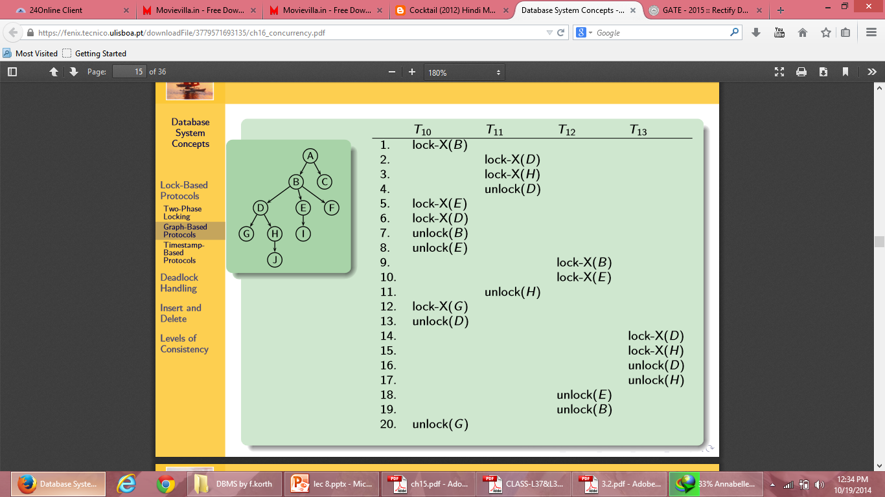
Graph Based Protocol: Example

Slide 18
Graph Based Protocol
Advantages:
The tree protocol ensures conflict serializability as well as freedom from deadlock.
Unlocking may occur earlier in the tree-locking protocol than in the two-phase locking protocol.
shorter waiting times, and increase in concurrency
protocol is deadlock-free, no rollbacks are required
Disadvantages:
Transactions may have to lock data items that it does not access.
increased locking overhead, and additional waiting time
potential decrease in concurrency

Slide 19
Time Stamp Based Protocol
Each transaction is issued a timestamp when it enters the system. If an old transaction Ti has time-stamp TS(Ti), a new transaction Tj is assigned time-stamp TS(Tj) such that TS(Ti) <TS(Tj).
The protocol manages concurrent execution such that the time-stamps determine the serializability order.
In order to assure such behavior, the protocol maintains for each data Q two timestamp values:
W-timestamp(Q) is the largest time-stamp of any transaction that executed write(Q) successfully.
R-timestamp(Q) is the largest time-stamp of any transaction that executed read(Q) successfully.

Slide 20
Time Stamp Based Protocol
Use the value of the system clock as the timestamp; that is, a transaction’s timestamp is equal to the value of the clock when the transaction enters the system.
Use a logical counter that is incremented after a new timestamp has been assigned; that is, a transaction’s timestamp is equal to the value of the counter when the transaction enters the system.

Slide 21
Time Stamp Based Protocol
The timestamp ordering protocol ensures that any conflicting read and write operations are executed in timestamp order.
Suppose a transaction Ti issues a read(Q)
If TS(Ti) ≤ W-timestamp(Q), then Ti needs to read a value of Q that was already overwritten. Hence, the read operation is rejected, and Ti is rolled back.
If TS(Ti)≥ W-timestamp(Q), then the read operation is executed, and R-timestamp(Q) is set to max(R-timestamp(Q), TS(Ti)).

Slide 22
Ti=Read Q
TS(T1)<= W-timestamp(Q)
Eg: TS(T1)=9:00:00 data item Q=1000
W-timestamp=9:00:01 data item Q=1100 by T2
When T1 issues read operation, the value of Q at 9:00:00 will be read, which is already updated by T2 to 1100 at 9:00:01. The value which T1 is going to read will be incorrect. . Hence, read operation of T1 will be rejected.

Slide 23
Ti=Read Q
TS(T1)>= W-timestamp(Q)
Eg: W-timestamp=9:00 data item Q=1100
TS(T1)=9:05
When T1 issues read operation, the value of Q updated recently will be read, which will be the correct value. Hence, read operation of T1 will be executed.

Slide 24
Time Stamp Based Protocol
Suppose that transaction Ti issues write(Q).
If TS(Ti) < R-timestamp(Q), then the value of Q that Ti is producing was needed previously, and the system assumed that that value would never be produced. Hence, the write operation is rejected, and Ti is rolled back.
If TS(Ti) < W-timestamp(Q), then Ti is attempting to write an obsolete value of Q. Hence, this write operation is rejected, and Ti is rolled back.
Otherwise, the write operation is executed, and W-timestamp(Q) is set to TS(Ti).

Slide 25
Ti=Write Q
TS(T1)<=R-timestamp(Q)
Eg: TS(T1)=9:00:00
R-timestamp=9:00:01 by T2
When T1 issues write operation, the value of Q which is going to be written by T1 will not be used now, because T2 has already read the previous value of Q at 9:00:01 before it was updated by T1. Hence, write operation of T1 will be rejected.

Slide 26
Ti=Write Q
TS(T1)<= W-timestamp(Q)
Eg: TS(T1)=9:00:00
W-timestamp=9:00:01 by T2
When T1 issues write operation, the value of Q which is going to be written by T1 will not be used now, because T2 has already written a new value of Q at 9:00:01 before it was written by T1. Hence, write operation of T1 will be rejected.

Slide 27
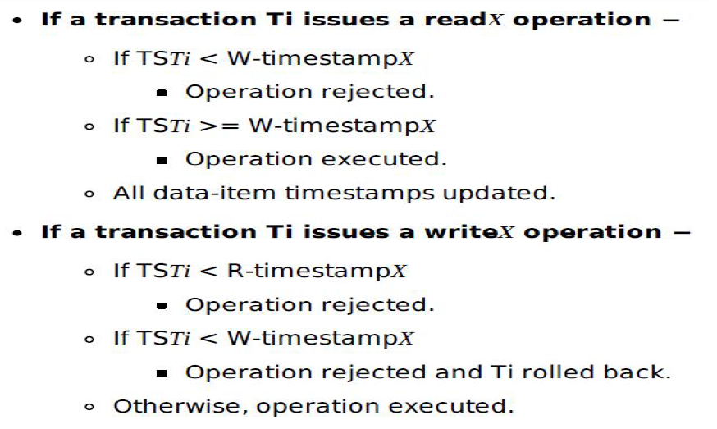

Slide 28
Time Stamp Based Protocol: Example
To illustrate this protocol, we consider transactions T₁ and T₂. Transaction T₁ displays the contents of accounts A and B:
T₁:
read(B);
read(A);
display(A + B);
T₂:
read(B);
B := B − 50;
write(B);
read(A);
A := A + 50;
write(A);
display(A + B);

Slide 29
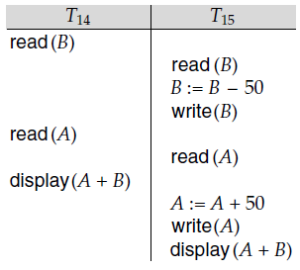
Time Stamp Based Protocol
In presenting schedules under the timestamp protocol, we shall assume that a transaction is assigned a timestamp immediately before its first instruction. Thus, in schedule 3, TS(T₁) < TS(T₂), and the schedule is possible under the timestamp protocol.
Schedule 3

Slide 30
Validation Based Protocol
We assume that each transaction T_{i} executes in two or three different phases in its lifetime, depending on whether it is a read-only or an update transaction. The phases are, in order,
Read phase. During this phase, the system executes transaction T_{i}. It reads the values of the various data items and stores them in variables local to T_{i}. It performs all write operations on temporary local variables, without updates of the actual database.

Slide 31
Validation Based Protocol
Validation phase. Transaction T_{i} performs a validation test to determine whether it can copy to the database the temporary local variables that hold the results of write operations without causing a violation of serializability.
Write phase. If transaction T_{i} succeeds in validation (step 2), then the system applies the actual updates to the database. Otherwise, the system rolls back T_{i}.

Slide 32
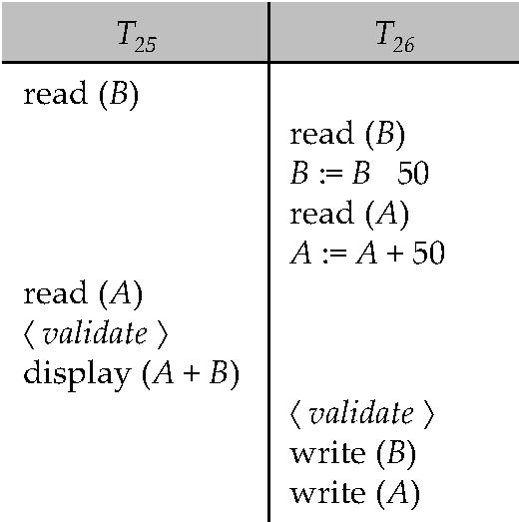
Validation Based Protocol
Each transaction Ti has 3 timestamps
Start(Ti) : the time when Ti started its execution
Validation(Ti): the time when Ti entered its validation phase
Finish(Ti) : the time when Ti finished its write phase

